Slide 2
THE DISCIPLES RELATIONSHIP:
TO HIMSELF
An Athlete
A Soldier
TO HIS LORD
The Potter and the Clay
The Vine and the Branches
A Child of God
TO HIS BRETHREN
A Member of the Body
“My Brother’s Keeper”
A Servant
TO THE WORLD
Strangers & Pilgrims
Salt & Light
An Apologist
Fishers of Men

Slide 3
LESSON 1: WHAT IS DISCIPLESHIP? The Disciples Identity
Then He said to them all, If anyone desires to come after Me, let him deny himself, and take up his cross daily, and follow Me. (Luke 9:23)

Slide 4
What is Discipleship?
A learner or pupil
A disciple is a devoted supporter and follower of his teacher.
He accepts the views of his teacher and adopts his teacher’s way of life.

Slide 5
THE DEMANDS OF DISCIPLESHIP
Luke 14:33, John 8:31
We must…
We must deny Self
We must be willing to suffer
We must learn from Jesus
We must bear fruit
We must love our brethren
We must be committed to following Christ

Slide 6
Deny Self
We must…
Deny Self
Be willing to suffer
Learn from Jesus
Bear fruit
Love our brethren
Be committed to following Christ
“…If anyone wishes to come after Me, he must deny himself, and take up his cross daily and follow Me.” (Luke 9:23)
Luke 14:26-27, Gal 2:20, 2 Cor 5:9

Slide 7
Be willing to suffer
We must…
Deny Self
Be willing to suffer
Learn from Jesus
Bear fruit
Love our brethren
Be committed to following Christ
“…If anyone wishes to come after Me, he must deny himself, and take up his cross daily and follow Me.” (Luke 9:23)
2 Tim 3:12

Slide 8
Learn from Jesus
We must…
Deny Self
Be willing to suffer
Learn from Jesus
Bear fruit
Love our brethren
Be committed to following Christ
“…If anyone wishes to come after Me, he must deny himself, and take up his cross daily and follow Me.” (Luke 9:23)
John 8:30-31, Matt 11:29, Matt 28:19-20, Luke 6:46

Slide 9
Bear fruit
We must…
Deny Self
Be willing to suffer
Learn from Jesus
Bear fruit
Love our brethren
Be committed to following Christ
“My Father is glorified by this, that you bear much fruit, and so prove to be My disciples.” (John 15:8)
2Pet. 1:5-8, Matt. 25:34-46, Eph. 2:10, Matt. 25:14-30

Slide 10
Love our brethren
We must…
Deny Self
Be willing to suffer
Learn from Jesus
Bear fruit
Love our brethren
Be committed to following Christ
“A new commandment I give to you, that you love one another, even as I have loved you, that you also love one another. By this all men will know that you are My disciples, if you have love for one another.” (John 13:34-35)
Col. 3:14, 1John 4:12, 20-21, Gal. 5:14-15

Slide 11
Be committed to following Christ
We must…
Deny Self
Be willing to suffer
Learn from Jesus
Bear fruit
Love our brethren
Be committed to following Christ
“I will follow You wherever You go…permit me first…” (Luke 9:57-62)
Luke 9:23, Luke 14:28

Slide 12
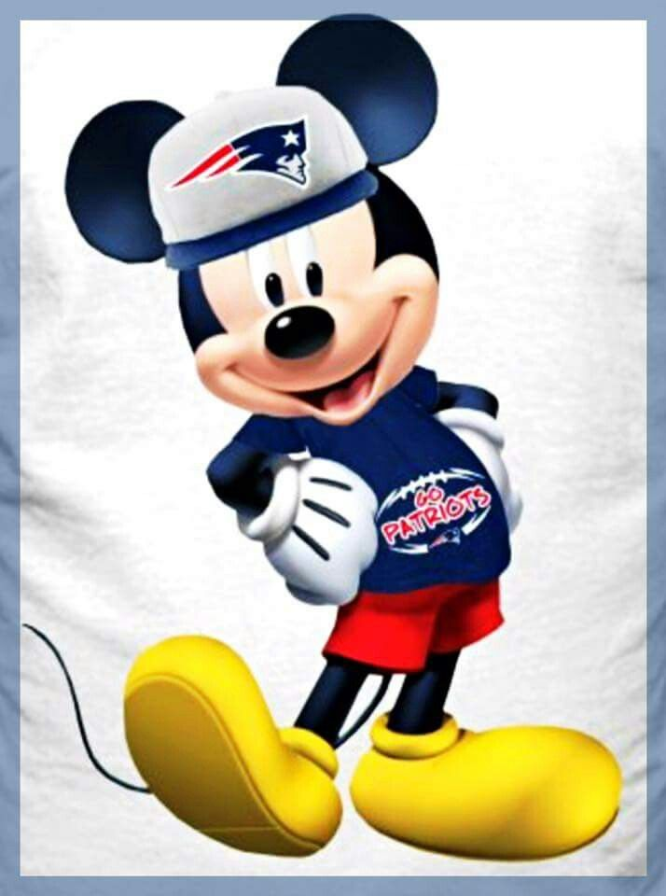
Identity
We must…
Deny Self
Be willing to suffer
Learn from Jesus
Bear fruit
Love our brethren
Be committed to following Christ

Slide 13
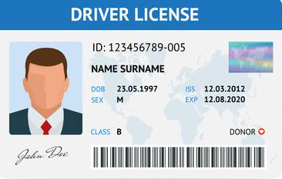
Identity
We must…
Deny Self
Be willing to suffer
Learn from Jesus
Bear fruit
Love our brethren
Be committed to following Christ

Slide 14
Discipleship this week
What have you suffered this week for the sake of Christ?
How healthy is your study time in God’s word? How are you doing in following His will?
What fruits have you bore this week?
How have you shown your commitment to Christ this week?
Who will people identify you with when they see you this week?

